Slide 1
Functions and Dictionaries
HIT137 Software Now
Week 04

Slide 2

We extend our respect to Elders - past, present and emerging - and to all First Nations people.

Slide 3

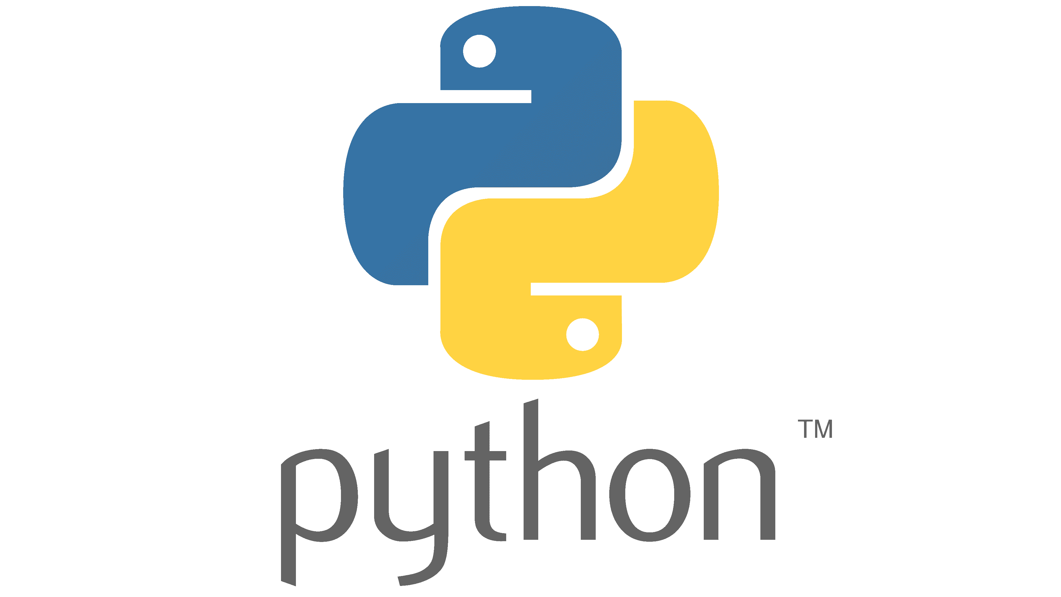
Outline
Understanding of:
Construct lists and access items in those lists
Use methods to manipulate lists
Perform traversals of lists to process items in the lists
Define simple functions that expect parameters and return values
Construct dictionaries and access entries in those dictionaries
Use methods to manipulate dictionaries
Decide whether a list or a dictionary is an appropriate data structure for a given application

Slide 4
Introduction
A list allows the programmer to manipulate a sequence of data values of any types
A dictionary organizes data values by association with other data values rather than by sequential position
Lists and dictionaries provide powerful ways to organize data in useful and interesting applications

Slide 5
Lists
List: Sequence of data values (items or elements)
Some examples:
Shopping list for the grocery store
Guest list for a wedding
Recipe, which is a list of instructions
Text document, which is a list of lines
Words in a dictionary
Each item in a list has a unique index that specifies its position (from 0 to length – 1)

Slide 6
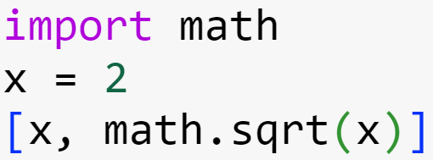
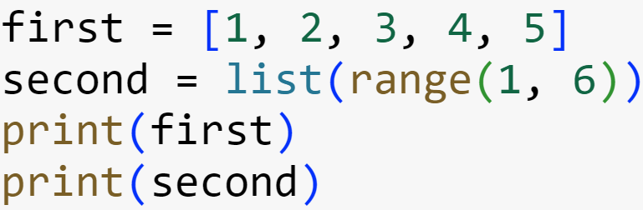


List Literals and Basic Operators
Some examples:
['apples', 'oranges', 'cherries']
[[5, 9], [541, 78]]
When an element is an expression, its value is included in the list:
Lists of integers can be built using range!
Output
Output

Slide 7
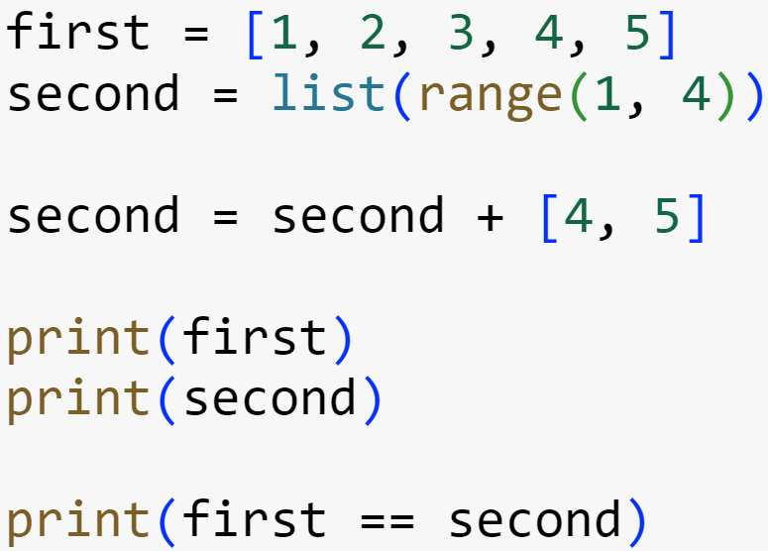
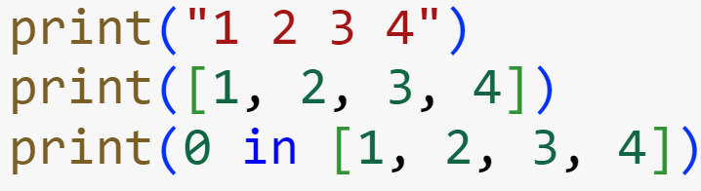


List Literals and Basic Operators
Output
Output

Slide 8
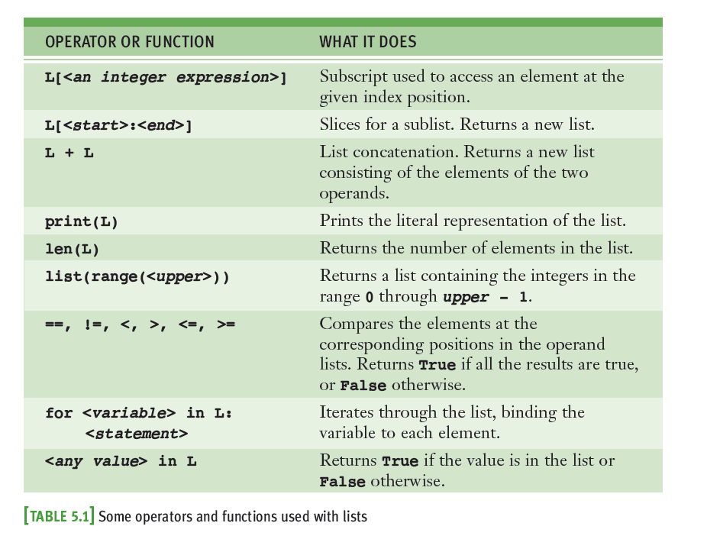
List Literals & Basic Operators

Slide 9
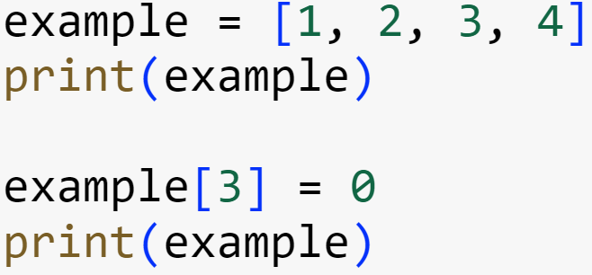
Replacing an Element in a List
A list is mutable!
Elements can be inserted, removed, or replaced
The list itself maintains its identity, but its state—its length and its contents—can change
Subscript operator is used to replace an element:
Subscript is used to reference the target of the assignment, which is not the list but an element’s position within it

Slide 10
Coding
Refer to PDF_CODE

Slide 11
List Methods for Inserting and Removing Elements
The list type includes several methods for inserting and removing elements

Slide 12
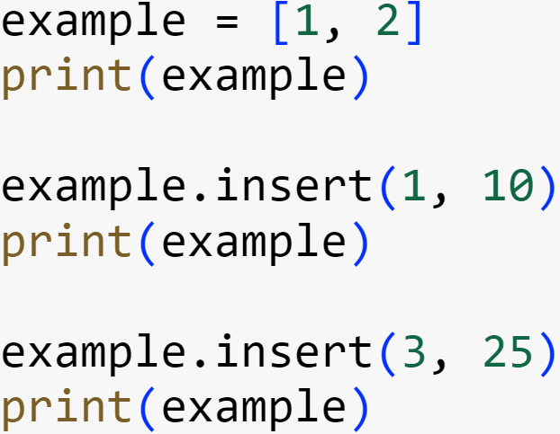
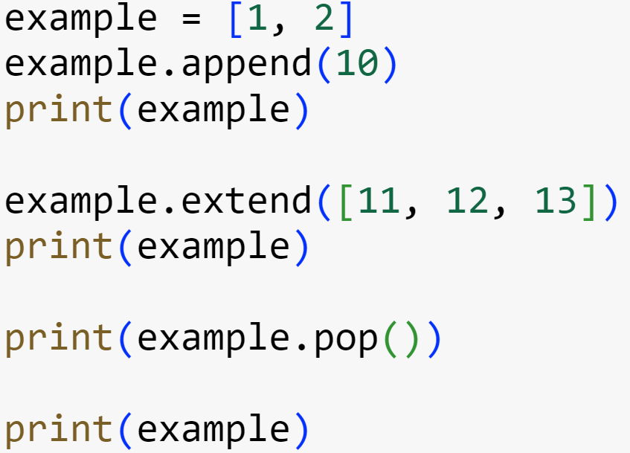

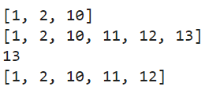
List Methods for Inserting and Removing Elements
Output
Output

Slide 13
Searching and Sorting a List
Refer to PDF_CODE

Slide 14
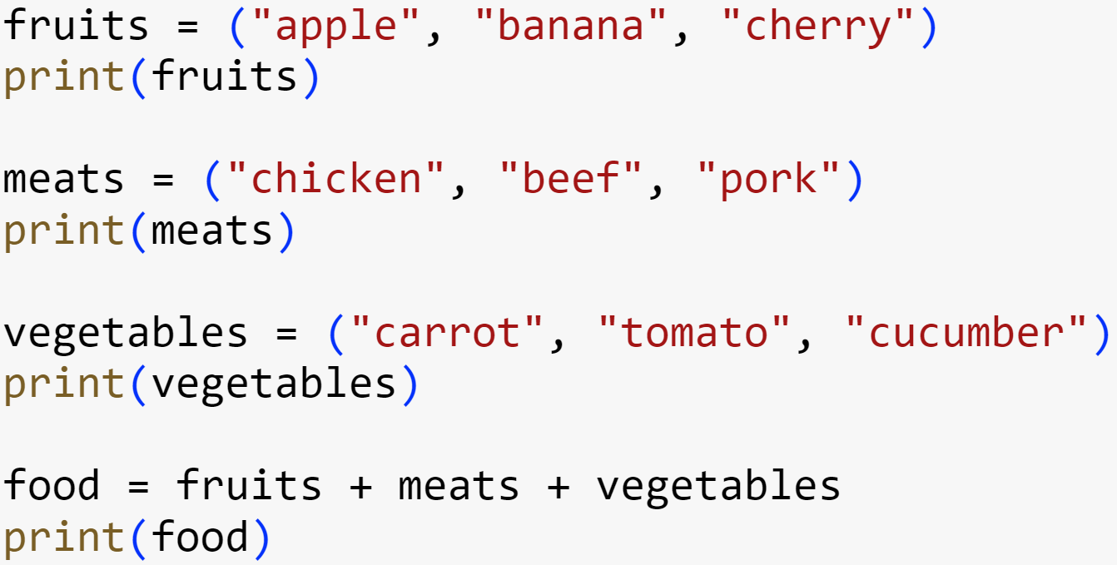
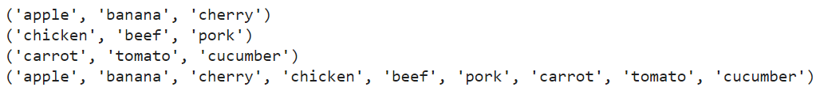
Tuple
A tuple resembles a list, but is immutable
Most of the operators and functions used with lists can be used in a similar fashion with tuples
Output

Slide 15
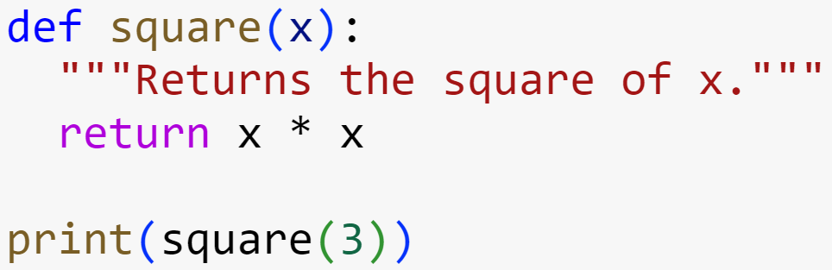
The Syntax of Simple Function Definitions
Definition of a function consists of header and body
Syntax of a function definition:
Output

Slide 16
Parameters and Arguments
A parameter is the name used in the function definition for an argument that is passed to the function when it is called
For now, the number and positions of arguments of a function call should match the number and positions of the parameters in the definition
Some functions expect no arguments
They are defined with no parameters

Slide 17
The Return Statement
Place a return statement at each exit point of a function when function should explicitly return a value
Syntax:
If a function contains no return statement, Python transfers control to the caller after the last statement in the function’s body is executed
The special value None is automatically returned

Slide 18
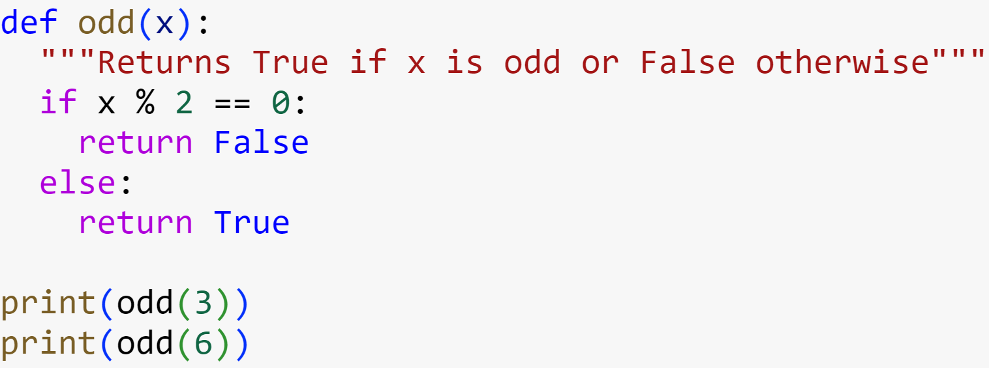

Boolean Function
A Boolean function usually tests its argument for the presence or absence of some property
Returns True if property is present; False otherwise
Example:
Output

Slide 19
Defining a main Function
main serves as the entry point for a script
Usually expects no arguments and returns no value
Definition of main and other functions can appear in no particular order in the script
As long as main is called at the end of the script

Slide 20
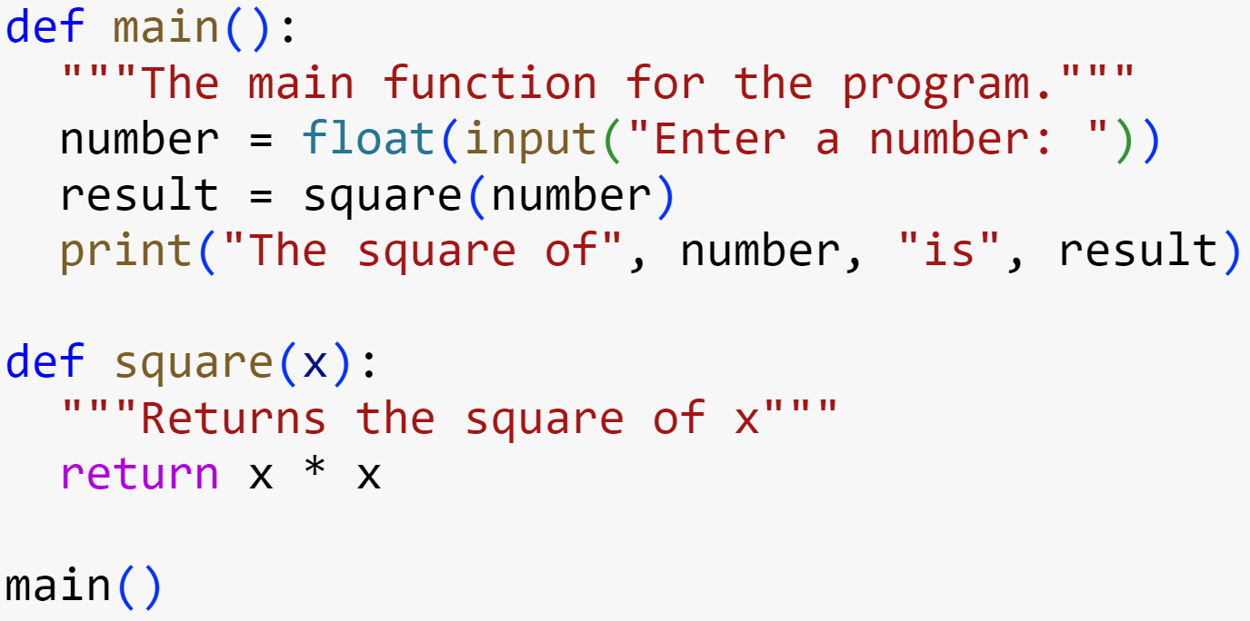

Defining a main Function
Output

Slide 21
Running main
Refer to PDF_CODE

Slide 22
Dictionaries
A dictionary organizes information by association, not position
Example: When you use a dictionary to look up the definition of “mammal,” you don’t start at page 1; instead, you turn to the words beginning with “M”
Data structures organized by association are also called tables or association lists
In Python, a dictionary associates a set of keys with data values

Slide 23
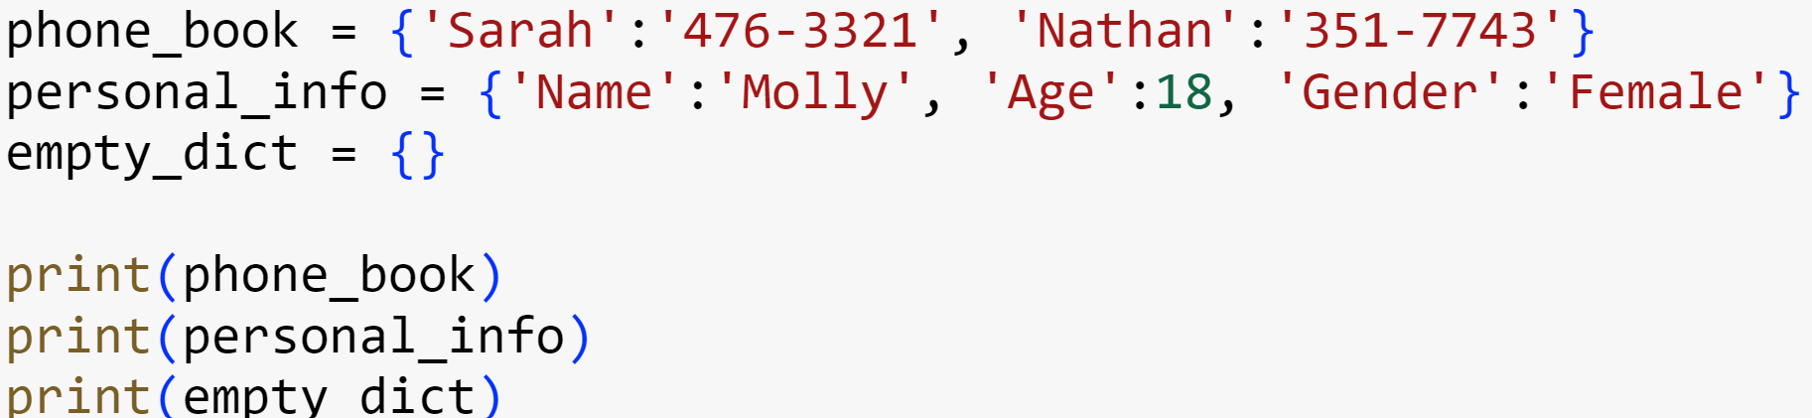
Dictionary Literals
A Python dictionary is written as a sequence of key/value pairs separated by commas
Pairs are sometimes called entries
Enclosed in curly braces ({ and })
A colon (:) separates a key and its value
Examples:

Slide 24
Dictionaries
Refer to PDF_CODE

Slide 25
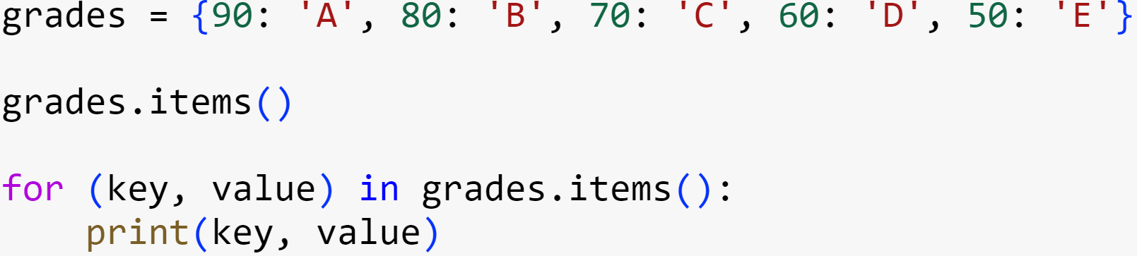
Traversing a Dictionary – key and value
To print all of the keys and their values:

Slide 26
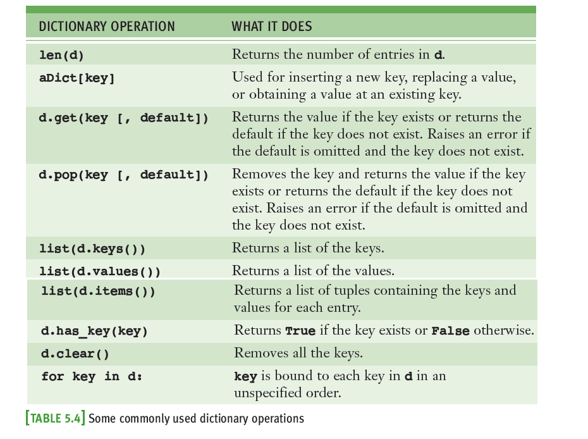
Traversing A Dictionary

Slide 27
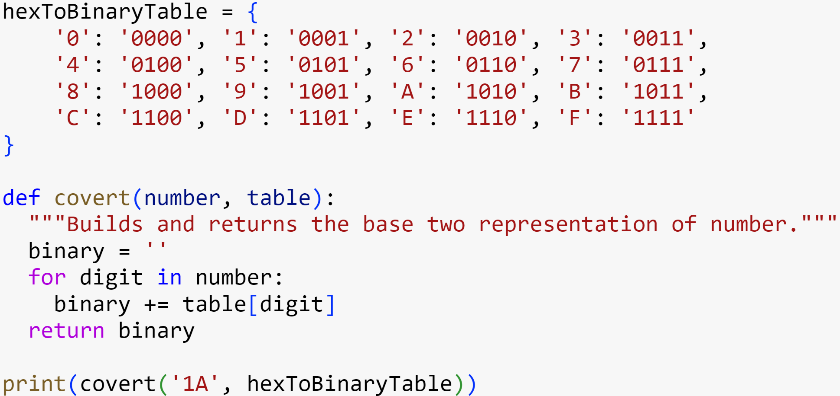
The Hexadecimal System Revisited

Slide 28
Tutorial Session
Start Solving Tutorial Questions

Slide 29
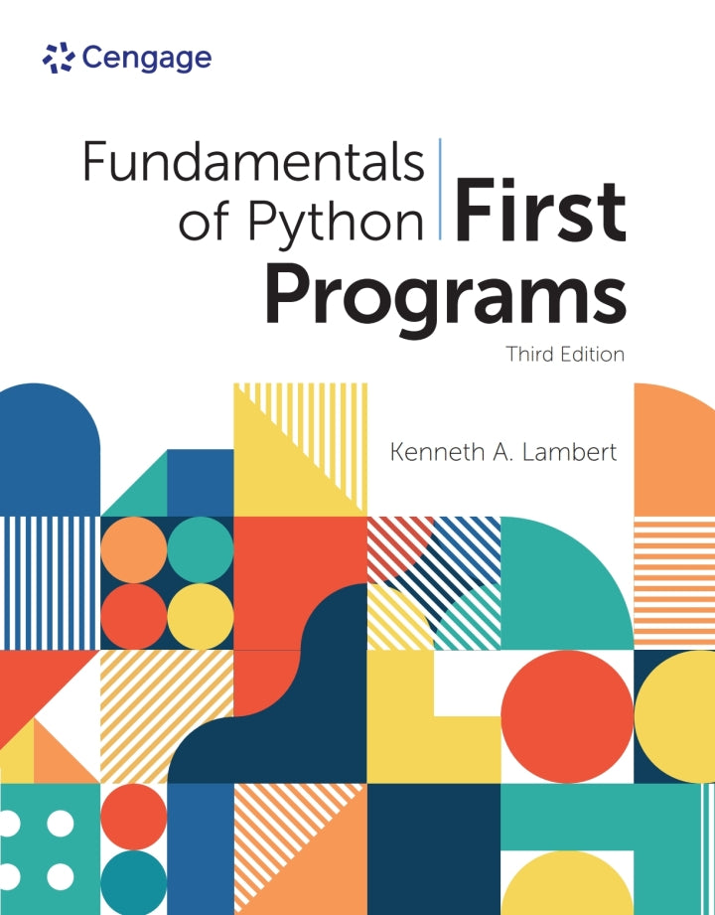
Resources
Some great resources to start your work :
Fundamentals of Python: First Programs
https://www.w3schools.com/python/default.asp
https://python.swaroopch.com/

